Slide 1
Higher Expectations Equal Increased Student Success:
INCORPORATING ADVANCED PLACEMENT IN THE ACADEMIES
Notes:
Welcome to this session. I’m Susannah Bell and I’m currently a professional development coordinator at Berkeley High. Until 2011, I taught English in a public service academy at Berkeley High School. This is Amy Crawford, English teacher in Communication Arts and Sciences Academy at Berkeley High. We are here to present to you a model for offering Advanced Placement English without tracking your students. Please feel free to stop us and ask questions as we go.

Slide 2
Survey
Raise your hand if…
…you are an English teacher.
…you teach in a career academy.
…you have taught an AP class.
…you wonder if your students are prepared for college level reading and writing.
…you have misgivings about the philosophy of Advanced Placement.
Notes:
First we want to get some information about who you are.

Slide 3
The AP English Augmented and Infused Curriculum Approach
Notes:
This infused model so is now offered in all four career academies at Berkeley High. Overview of how it works – handout.

Slide 4
Context: Berkeley High School
Academies | Programs
Community Partnerships Academy (CPA) | Academic Choice (AC) Approximately 1500 students
Arts and Humanities Academy (AHA) | Berkeley International High School (BIHS) Approximately 800 students
Green Academy (GA)
Communication Arts and Sciences (CAS)
Approximately 240 students per academy.
Notes:
Context: Not wall to wall academies, and we are in a University town. There are parts of the school where many, many AP classes are offered, and so traditionally high-achieving students are often reluctant to come into the academies.
Our four academies tend to serve a more diverse and generally a lower-skilled population.

Slide 5
Academy Demographics at Berkeley High
40% African
American
30% White
30% Other
___________
29% Latino
7% EL
12% Sped
40% SED
Notes:
These are the overall demographics of our four BHS academies. Each of the Academies looks a little different, and it changes each year because we have a lottery system, but we tend to have a larger number of students of color, and certainly a larger number of at-risk students than the school at large.

Slide 6
AP-The Dilemma | Benefits | The Solution: AP Augmentation Model
Perception of elitism Perception of skill deficit Tracking Scheduling Funding | College Board accreditation/transcripts Equity College preparation High expectations | Integrated with regular class (AP Students must take both) = no tracking Summer Reading Zero or seventh period T/Th or M/W Online Component
Notes:
We want to give you a little thinking about how this program came about and why the academies have historically been resistant to AP. Amy: CAS’s resistance to AP, Syllabus explanation. Susannah—benefits: It helps students show colleges that they took the most rigorous course available to them. In a place where people talk a lot about the achievement gap, you can’t really leave ap out it. We don’t want to just get kids to college, we want them to be successful once they get there. We want to communicate really high expectations for all our students. Talk about possibility for different models.

Slide 7
College Board Approved
College Board approved combined curriculum:
Regular English + Augmentation
Junior Year – AP Literature, coincides with American Literature
Senior Year – AP Language, coincides with Composition and Writing
Themes and content between the regular English class and the augmentation are totally integrated
Students in AP section do additional work on the same literature.
Notes:
Such as: timed writes, essays, test practice

Slide 8
AP Augmentation: English Language & Composition
amycrawford@berkeley.net
My Goal—To prepare students for college writing by developing
critical thinking & reading skills
effective academic writing style
writing speed & efficiency

Slide 9
Class meetings
Tuesday & Wednesday, 3:35-4:35
Attendance is mandatory!
Currently:
Homework is to re-read & annotate an essay in preparation for discussion plus write a rhetorical analysis essay on the essay we discussed during the last meeting
After summer reading:
One day reading & discussing
One day timed essay writing/multiple choice practice
Notes:
Amy’s class schedule – some teachers teach from 7:30 – 8:30 am.

Slide 10
Class meetings
Currently:
Synthesis Writing
Multiple Choice Strategies
Strategic Reading
Rhetorical Vocabulary Review
On Deck:
Argument Essay
Test taking strategies

Slide 11
The AP Exam
A requirement of the class that happens mid-May (fee reductions & IEP/504 accommodations are available and must be requested in advance)
A passing score of 3 or higher excuses students from one semester of college English in most universities in the US.
3 Essays:
Rhetorical Analysis
Argument
Synthesis
Multiple Choice

Slide 12
Funding
Cost:
English teacher released .2 FTE per each 2 sections at a particular grade level.
Sign-ups determine the size of the section.
With 2 sections/grade, if 1/2 sign up = one full AP section
Two Academies can share a section but the teachers must collaborate very closely as regular and AP sections are integrated.
Notes:
Often AP classes end up with small class sizes because they are hard, and a percentage of students drop them. This is also the case with the AP Augmentation. That is why pre-AP curriculum in the 9th and 10th grades has been so important. Writer Coaches.
Inclusion of AP in the Academy program attracts students who think of themselves as college bound. It ensures that some high performing students see the Academy as a place they will be challenged. That provides an essential base of more motivated students.

Slide 13
Funding Sources
CPA funds have been used
General funds have been allocated by the principal or the Site Leadership Team to support a promising equity-based program
After-school program or
Summer School funds
Title 1 School-Wide Programs funds
Notes:
The last two – we have not used, but they should be applicable.

Slide 14
Skill Development in 9th and 10th grade plus strong recruitment
Writer Coaches
Seniors go into sophomore classes in the spring to talk about the value of the AP augmentation
College-going alumni presentations to juniors include the value of the AP Augmentation in their first year in college
Notes:
Outside grant funding

Slide 15
Who Benefits? - EVERYONE
Between 30 - 60% of the full grade level usually decide to take AP Augmentation.
In each regular English class, there are 9-18 students also taking AP.
Teacher delivers AP curriculum to all students.
Students taking AP get “time and a half.”
Increased level of discourse / skill development for all students.
Notes:
The idea behind this model is that all students benefit from higher expectations. Because we serve students who have experience an opportunity gap, they increased amount of time spent on ELA is extremely valuable.

Slide 16
Academy vs. Large School Demographics
 | CPAs (n=808) | BHS (-CPAs) (n=2066)
Primary Race:
African American | 40% | 20%
White | 30% | 50%
Other Race | 30% | 30%
SED | 40% | 23%
Latino | 29% | 18%
Special Education | 12% | 7%
English Learner | 7% | 3%
Parent Education Level:
College degree | 41% | 64%
HS Diploma or less | 8% | 4%

Slide 17
AP Demographics at Berkeley High School
Large School
CP Academy
Notes:
Who is getting pushed? Who is getting this push—students who have been traditionally left out of AP. Amy: outreach to ELLs for extra English instruction

Slide 18
AP Supports ALL Students
Brian: “I had to retake the [CAHSEE] test one time. I retook it at the beginning of my eleventh grade year, after I had been in the AP class for about a month. After being in AP, listening and participating in the discussions of my classmates – everything was at such a high level…. I got into the exit exam and I was like ‘this is a piece of cake!’”
Brian is an IEP student who took the CAHSEE without accommodations. He passed easily on his second try with a fifty point increase.

Slide 19
Differentiation
“AP Augmentation solves one of the most challenging pedagogical questions we face: how to effectively differentiate up. Too often we think of differentiation as only a way to help lower-skilled students advance more quickly, and we forget that it also applies to how we can spur our highest-skilled students to even greater academic heights. Augmentation allows them to be challenged while maintaining the sanctity of our tight-knit community, and it also helps them develop leadership skills as they reinforce concepts with their classmates.” – John Becker, AHA!
Notes:
Amy--The push to students who are really looking for it. We want to to serve at risk kids, but we also believe in the power of heterogeneous classrooms, and this program allows us to attract and retain traditionally higher achieving students.

Slide 20
Testimonials
Gabriela Guerrero – “At first when
joining AP English I decided to not
continue on with the program because
I was already taking an English class
and I didn’t think it was necessary.
As the class went on, my writing has
become more fluent. I am able to put
my ideas together faster than before, because in AP we have to do timed writes. This has improved my organization and outlining skills. My writing has improved because of this
class because we get more practice writing essays that we can certainly use in other classes and in college.”

Slide 21
Testimonials, contd.
Chanay Jackson – “This year I am in the 12th grade taking Senior Composition and Writing and I think that I am doing a whole lot better than in my past years in Ms. Bell’s class. I think it is like this because it is more demanding. I think this is a better way for me to learn.”
These two students are among a number too significant to ignore who consistently earned D/F grades throughout grades 9-11, but who improved considerably their senior year even though the curriculum is much more challenging.

Slide 22
Transfer of Skills
Nicole Miller c/o 2013
“This class has helped me become more confident in my essay writing. I have changed the way I look at essays as well as approach them. I see them as a way of making a point or expressing myself, and I now even structure my points and feelings before expressing them publicly.”
-Student Name

Slide 23
A 2 = better college performance
A 2007 University of Texas study found “strong evidence of benefits to students who participate in both AP courses and exams in terms of higher GPAs, credit hours earned and four year college graduation rates.”
Mathews, Jay. “Studies Find Benefits to Advanced Placement Courses.”
Washington Post Online 8 February 2007.<www.washingtonpost.com/
wp-dyn /content/article/2007/01/28/ AR2007012801238_pf...>.

Slide 24
Skill Development – College Preparation
The College Board said that students who got a 2 or higher were more likely to earn a bachelor’s degree within four years than other students. Some educators say that being exposed to college-level work helps even those students who fail the exam. “It doesn’t get you college credit if you get a 1 or a 2, but I think it does provide students with a sense of the kind of skills and critical thinking that college will require from them,” said Jean Robinson, associate dean for undergraduate education at Indiana University. “I think the focus shouldn’t be so much on students obtaining credit and taking care of some intro course while they’re in high school, as on getting the skills they’re going to need.”
February 11, 2010

Slide 25
AP Infusion improves the skill levels of all students
Of those students in the Class of 2007 who took “regular” English (but were exposed to the AP curriculum):
96% attended college
95% earned A, B or C in English 1A their first semester
100% stated “I felt completely prepared for College English.”

Slide 26
Test Scores 2009-2011
2009 AP Language (CPA) – 50% passed, 85% scored 2 or higher (2nd year of AP Augmentation)*
2010 AP Literature (CPA/Green) – 20% passed, 77% scored 2 or higher (1st year of AP Augmentation) -of those students who scored 2 or better, 55% were non-White
2011 AP Language (CAS) – 80% passed (1st year of AP Augmentation) – 4 earned 5s. Of those who didn’t pass, all earned 2s.
N = 30
Notes:
2 year program. AP lit first and why. Include at our students are telling us that English 1A is primarily non-fiction. Amy talk about rationale of having lang second. Paired with govt. and econ.
Now, let’s talk about test scores.

Slide 27
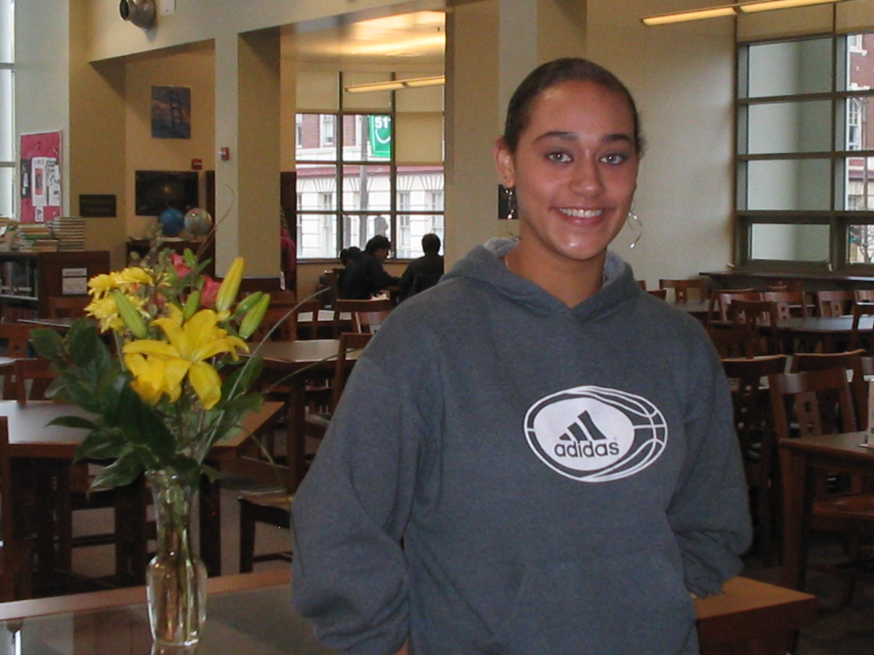
Class of 2009 Interviews
“College work is very rigorous, but I am prepared for it. I can say that I am prepared for this workload because I took two AP English courses at my high school.” --Nichelle Pete, UCLA
“I always thought that all of the reading Ms. Bell assigned was excessive but now I have discovered that it was simply preparation for what I would find here.” --Chelsa Greene, Occidental College

Slide 28
2009 Interviews, Continued
“The online component required in Ms.Bell’s AP classes prepared me for all of the work in college that is expected to be done through e-mail and on different blog sites – Ms. Bell’s AP Blog taught me not only how to maneuver my writing on a blog but also helped me get into the habit of looking at other people's work on line, editing on line, and making deadlines for on line assignments.”
-Chelsa Greene, Occidental College
Notes:
Talk about Moodle.

Slide 29
AP is increasing the number of students we send to 4 year higher education.
Green Academy first offered students the AP Augmentation option in 2009-10
14 of the 16 students who took AP English for two years got 4-year college acceptances
Double their previous 4-year college going rate

Slide 30
Ripples throughout the Academy
“To become a scientist, an engineer, a teacher, a lawyer, a health care professional, or a legislator, a person needs a capacity to access, interpret, analyze and articulate opinions about dense material, such as articles in scientific or medical journals. I can think of nowhere better for a student to get a foundation in these advanced critical reading skills than in AP English classes.”
-Kate Trimlett, Green Academy Science Teacher
Notes:
Amy talks about how colleagues are seeing the changes. Dagny Talks about why AP English and not others.

Slide 31
Career Preparation
Higher Level Reading and Writing are the most sought-after skills in the American workplace.
A 2001 survey by the National Science Foundation asked Bayer Corporation executives “If you could give advice to today’s high school and college students, which subjects would you urge them to take more of?”
96% ranked English/Writing/Reading subject area highest.

Slide 32
Materials in your packet
Month-by-month alignment of U.S. Literature with AP Literature and Composition (11th)
Detailed breakdown of focus for each section
Sample integration tools
Month-by-month alignment of Writing and Composition with AP Language (12th)
Detailed breakdown of focus for each section
Sample integration tools
Questions: Amy Crawford amycrawford@berkeley.net, Susannah Bell susannahbell@berkeley.net

Slide 33
What other academy teachers are saying
“Teaching AP has given me exactly the foundation I needed to begin making my students as accomplished writers as they are thinkers. This year, I’ve seen my seniors grow in leaps and bounds, especially in the areas of self-revision, concise articulation of ideas, and understanding the more arcane corners of grammar: semicolons, the active voice, etc. The really nice thing, besides collaborating with awesome people, has been that I’m teaching AP in the augmentation model. I don’t think I’d want to teach it any other way. I’ve always been resistant to AP’s elitism and inequities, to the point that I’d rather not teach it. Augmentation, though, has allowed me to take the quality curriculum that comes along with AP Language and give it to all of my students. It’s downright subversive that way.”
- John Becker, Arts & Humanities Academy (AHA!)

Slide 34
Closing the Opportunity Gap
Building a community of learners
Notes:
Some piece of under-achievement is about perception - teachers perceptions about students, and most importantly, students perceptions about themselves.
Encouraging students to believe in themselves and to support each other in taking risks is essential to improving student achievement. This program has helped us to strengthen student skills. But it has also strengthened our teachers’ confidence in student capacity, and it has therefore made us a stronger community of learners.

